Slide 1
NAVIGATING TODAY'S TALENT LANDSCAPE
THE PROFESSION AT A TIPPING POINT
Notes:
Thank you for the invitation to join you at the joint meeting of FEI and The Ohio Society of CPAs. I’m Barb Benton, vice president of government relations for The Ohio Society. I’m looking forward to sharing information, insights, and perspectives on a topic that’s impacting all of us—the accounting talent shortage. Regardless of the position you hold, the talent shortage is affecting you in one way or another.

Slide 2
THE NUMBERS BEHIND THE SHORTAGE
A look at how we got here
Notes:
We’ll begin our discussion with a look at how we got here.

Slide 3
INTERSECTION OF LOSS & DEMAND
Loss Overall
300,000 U.S. accountants and auditors who left their jobs between 2021-2023
Loss by Age
25 to 34-year-olds & 45 to 54-year-olds Leaving the profession
Demand
136,400 Projected annual job openings through 2031
Boomer Retirements
75% Individuals in the CPA workforce who reached retirement age in 2020
Notes:
Much like the supply and demand curves you may remember from your Econ 101 class, the accounting profession has as a dwindling supply of accountants and an increasing need for their services. AICPA estimates that nearly 75% of the CPA workforce met the retirement age in 2020. And non-Boomers are leaving, too. More than 300,000 U.S. accountants and auditors exited the profession over the last two years. Many of those are young and mid-career accountants who are tapping out. Per a study by Deloitte, a significant number of those individuals are transitioning into jobs in finance and technology where the hours are more reasonable, and the pay is higher. Organizations are challenged to find people with in-demand skills in…
Artificial intelligence
Robotic process automation
Machine learning

Slide 4
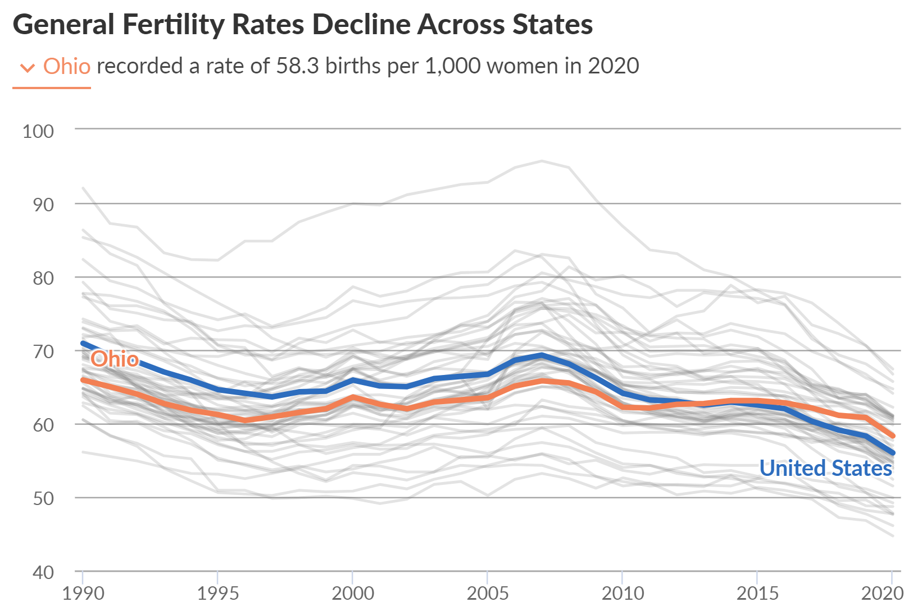
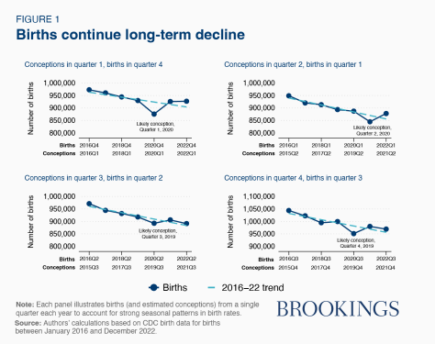
DECLINE IN BIRTH RATES
https://www.pewtrusts.org/en/research-and-analysis/issue-briefs/2022/12/the-long-term-decline-in-fertility-and-what-it-means-for-state-budgets
https://www.brookings.edu/articles/us-births-are-down-again-after-the-covid-baby-bust-and-rebound/
Notes:
The talent shortage did not happen overnight. It’s been a convergence of things we can and cannot control. In the category of uncontrollable is a decline in birth rates. You’ll notice that Ohio’s birth rates have—until recently—declined to a greater degree than what’s happening nationally.

Slide 5
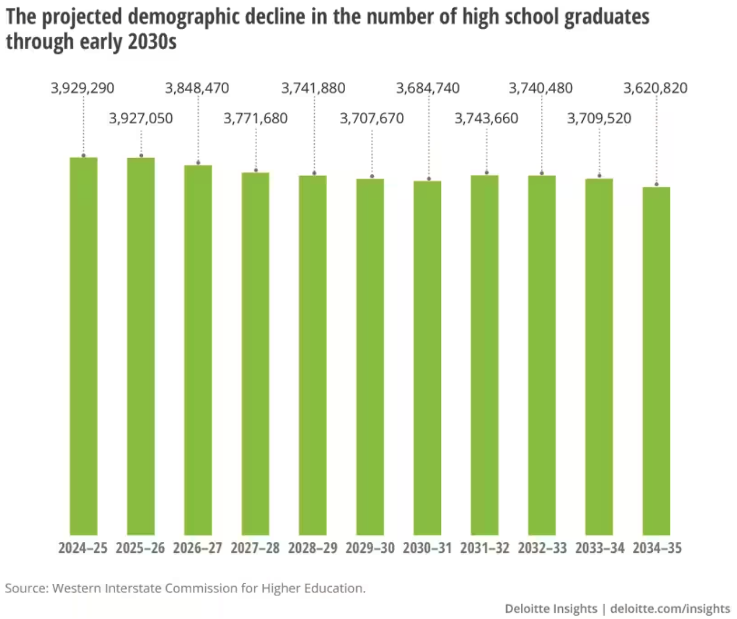
DECLINE IN NUMBER OF HIGH SCHOOL GRADUATES
https://www2.deloitte.com/us/en/insights/industry/public-sector/articles-on-higher-education/enrollment-rates-in-higher-education.html
Notes:
We’ve also seen a decline in the number of high school graduates, which is projected to continue through 2035.

Slide 6
DECLINE IN HIGHER ED ENROLLMENTS
https://nscresearchcenter.org/wp-content/uploads/CTEE_Report_Spring_2023.pdf
https://www2.deloitte.com/us/en/insights/industry/public-sector/articles-on-higher-education/enrollment-rates-in-higher-education.html
Notes:
Though overall college enrollments appear to be turning a corner, there has been a steady decline since 2020. While much of that may have been pandemic-related, more and more students are considering careers in the skilled trades. The cost of a trade school education is considerably lower than the cost of a college education. And for some skilled trades, salaries can reach the six-figure level.

Slide 7
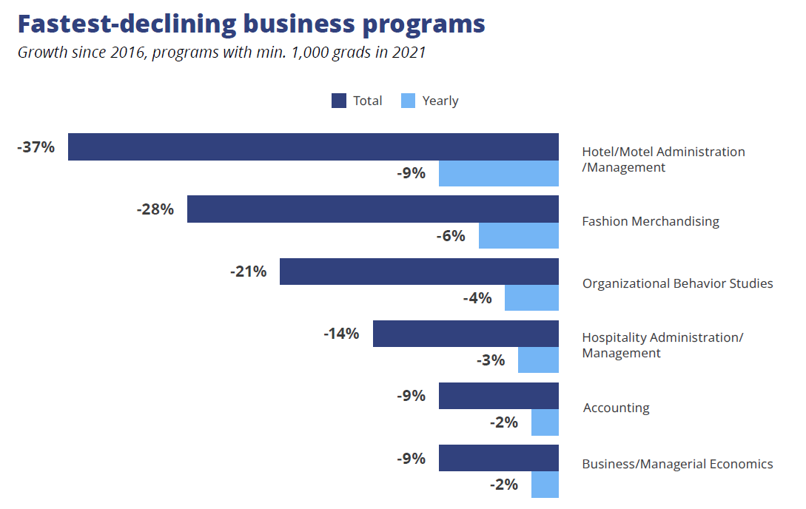
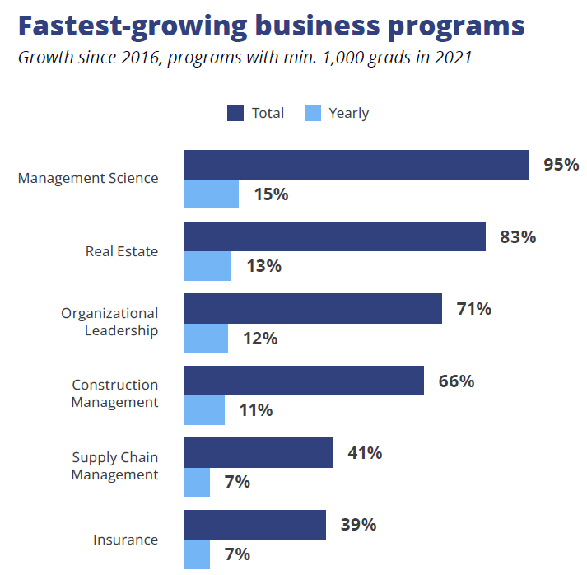
DECLINE IN ACCOUNTING ENROLLMENTS
https://universityservices.wiley.com/state-of-education-market-undergraduate-2023/
Notes:
In addition to a decline in overall college enrollments, we are also seeing a dip in accounting enrollments—accounting is one of the fastest-declining business programs. One of the fastest growing? Management science, which still has applicability to accounting.

Slide 8
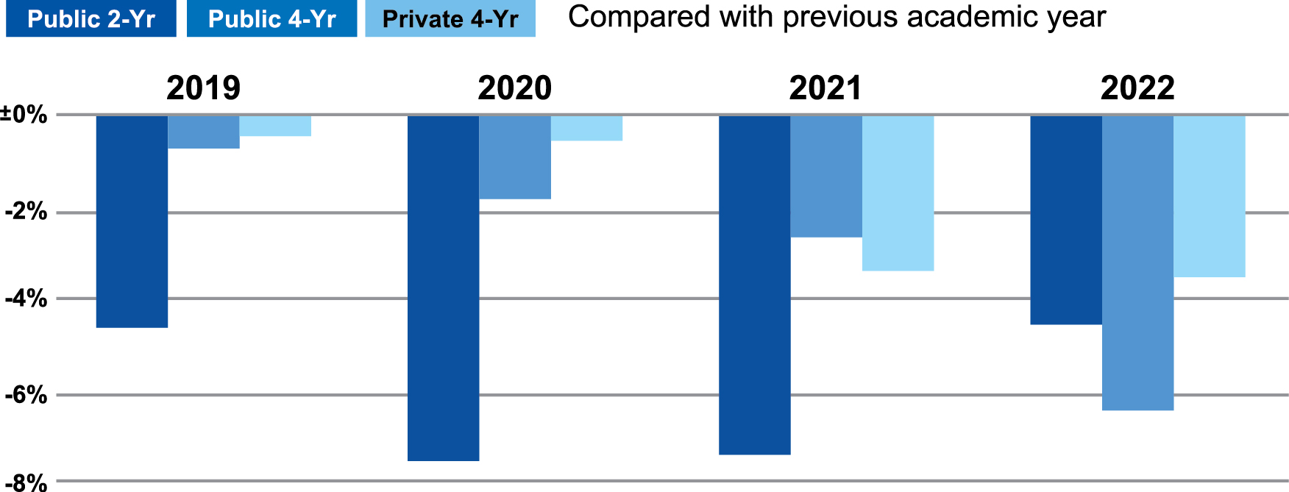
CHANGE IN OH COLLEGE ENROLLMENT ESTIMATES (BY SPRING SEMESTER)
Notes:
To this point, we’ve been reviewing the talent shortage through a national lens. Now let’s look at Ohio-specific numbers.
Overall, enrollments in Ohio’s colleges and universities are declining
Declines in two-year college enrollment appear to be rebounding to pre-pandemic levels but drops for 4-year schools in 2021-22 were the largest yet.
Statewide enrollment has dropped more than 11% since spring 2019, with just over 500,000 students enrolled in spring 2022
Interesting: Ohio State’s main campus enrollment hasn't been impacted as harshly as other Ohio universities.
Statewide full-time enrollment at university main campuses dropped 8% from 2011-21, Ohio State's increased 1%.
The big picture: College enrollment has been declining for nearly a decade across the nation, accelerated by COVID disruptions
Context: A tight labor market has led to availability of more entry-level jobs with boosted pay.
Meanwhile, the cost to attend a public 4-year school has tripled since 1990, calling into question the ROI of going into debt for a degree.
However, historically, college graduates earn significantly more throughout their lifetimes than people without degrees.
Ohio colleges and lawmakers are enacting new initiatives to increase affordability, including statewide second-chance grants, a debt-free degree program at Ohio State for low-income students and free tuition at Columbus State Community College for Columbus City Schools graduates.
Data: National Student Clearinghouse; Chart: Axios Visuals
https://ohiocpaeo.sharepoint.com/:w:/r/teams/Marketing/_layouts/15/Doc.aspx?sourcedoc=%7B987577A7-42E3-4E19-B929-D3925E60840D%7D&file=College%20enrollment%20decline.docx&action=default&mobileredirect=true

Slide 9
OHIO CPA LICENSE HOLDERS*
32%
52%
16%
36,277
Source: Accountancy Board of Ohio (*data current as of 4/4/2023)
Notes:
Bringing things closer to home, one of the most impactful statistics is the number of aging CPAs registered in our state. We recently analyzed Accountancy Board of Ohio data, which brought the state’s talent shortage into sharp perspective—it was truly eye-opening.
Of the CPAs registered in Ohio, nearly 45% are over 60 years old.
If we look at those who are over 50 years old, that percentage increases to more than 65%.

Slide 10
ACTIVE STATUS OHIO LICENSE HOLDERS
18,776 Number of Ohio CPAs with Active Licenses
Source: Accountancy Board of Ohio (*data current as of 4/4/2023)
Notes:
As we narrow our focus and look at just active license holders in Ohio, nearly 50% are over the age of 50.
Given the increasing wave of Boomer retirements, decreasing college and university enrollments, and declining number of students majoring in accounting, we have a perfect storm brewing in Ohio’s accounting talent arena, which is why significant action is needed. Now. Given that we cannot create more 22- to 35-year-olds, we must look at bold, innovative measures to resolve the talent challenges we face. I’ll share more on that a little later in the presentation.

Slide 11
CPA EXAM TRENDS
Notes:
What makes Ohio’s numbers even more bleak is the downward trend in CPA Exam passers. From a peak of more than 29,000 in 2010, there has been a steady decline. In 2022, less than 19,000 candidates passed their fourth section.

Slide 12
TOP REASONS FOR OPTING OUT OF ACCOUNTING
Long Hours
100+/wk Many students are seeking career options with better work/life balance
Stigma
BORING Perceptions that the work is tedious lead students to opt out of accounting
Hurdles
150 Obstacles such as the 150-credit hour requirement, and the cost involved are deterring students
Pay
$56K Lower average starting salaries are pushing potential accountants to other career paths
Notes:
There are some challenging hurdles to overcome to attract the number of students we need in the profession:
Pay: students are finding other career options with higher starting salaries
Long hours: students aren’t interested in working 100-hour work weeks
Reputation: students perceive accounting as boring and tedious
Hurdles: students see the CPA credential as a costly and time-consuming proposition

Slide 13
THE IMPACT ON OHIO BUSINESSES
The effects on credit ratings, financial statements, and more
Notes:
We’ll begin our discussion with a look at how we got here.

Slide 14
CITY AND MUNICIPAL CREDIT RATINGS AFFECTED
Credit ratings withdrawn for 64 local governments & utility systems
Marion & 148 other entities placed on negative credit watch
Accounting shortage preventing cities from filing financials on time
Cities facing challenges in financing much-needed projects
Notes:
The shortage of accounting professionals is also being felt in cities, townships, and municipalities across the nation—including right here in the Buckeye State. According to an article in Accounting Today, the city of Marion is delaying financing a new $10 million firehouse because it doesn’t have a credit rating.
Marion is among 64 local governments where S&P Global Rating has withdrawn or downgraded credit ratings.
The accounting shortage is preventing these cities from timely filing of required financial information.
As a result, capital expenditures are being delayed because cities can’t get financing.

Slide 15
MATERIAL MISSTATEMENTS ARE UP
Increase in companies reporting material weaknesses related to personnel since 2019
40.6%
SOURCE: https://www.wsj.com/articles/the-accountant-shortage-is-showing-up-in-financial-statements-b14a6b94?mod=djemCFO
Notes:
The accounting talent deficit is showing up in financial statements. According to the Wall Street Journal, research firm Bedrock AI found that nearly 600 U.S.-listed companies reported material weaknesses related to personnel.

Slide 16
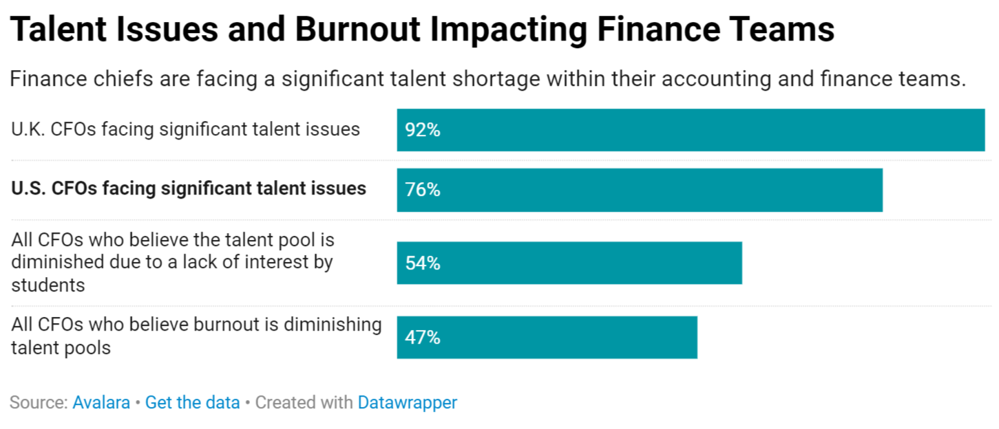
IMPACTS ON CORPORATE ACCOUNTING
SOURCE: Avalara
Notes:
I don’t have to tell those of you in corporate accounting that this accounting talent shortage is affecting you. A recent Avalara survey of more than 300 CFOs yielded some striking results.
84% of CFOs say they are facing significant talent challenges
While the shortage is impacting traditional accounting operations, it’s also hampering companies’ abilities to conduct analysis and formalize decision-making.
Nearly half of respondents indicated a need for financial planning and analysis expertise.
63% say their teams are green and lack the experience needed to do the work.
As a result, nearly 90% of CFO say they’re turning to AI to help address the gap.

Slide 17
ADDITIONAL RIPPLE EFFECTS ON BUSINESS
Difficulty in Financial Planning & Analysis
Increased Salary & Benefit Expense
Lack of Financial Insight
Employee Burnout & Turnover
Missed opportunities
Delays in Financial Reporting
Compliance Risks
Inefficiencies
Increased Workload on Existing Staff
Risk to Data Security
Impact on Audit Quality
Notes:
There are many other ripple effects in business, government, nonprofits, and academia. Businesses of all sizes have seen increases in employee burnout and turnover. Audit quality is suffering. Employee salary and benefit costs are increasing. Nonprofits are struggling to find firms that are willing to do their audits. Colleges and universities are challenged to find people to teach the next generation of accountants. The list of impacts seems endless.

Slide 18
IDENTIFYING POTENTIAL SOLUTIONS
Making the professional accessible to more people
Notes:
We’ve got our work cut out for us and our efforts must be aligned if we are to succeed in reversing the decline in accounting talent.

Slide 19
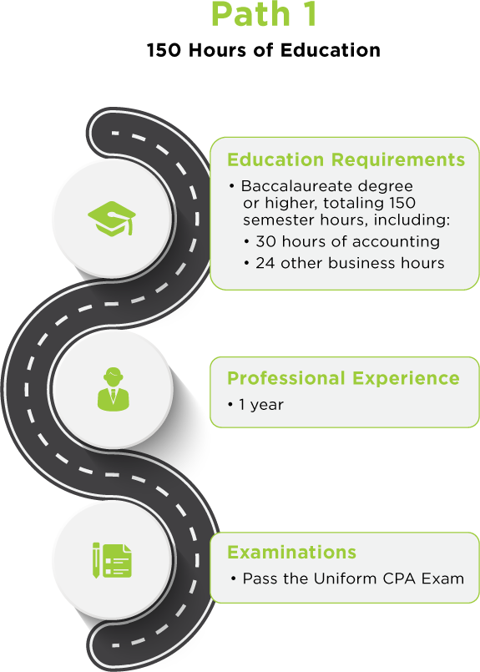
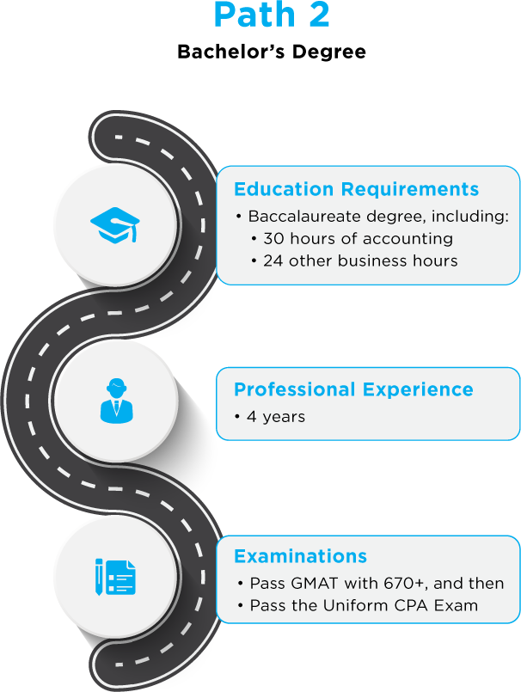
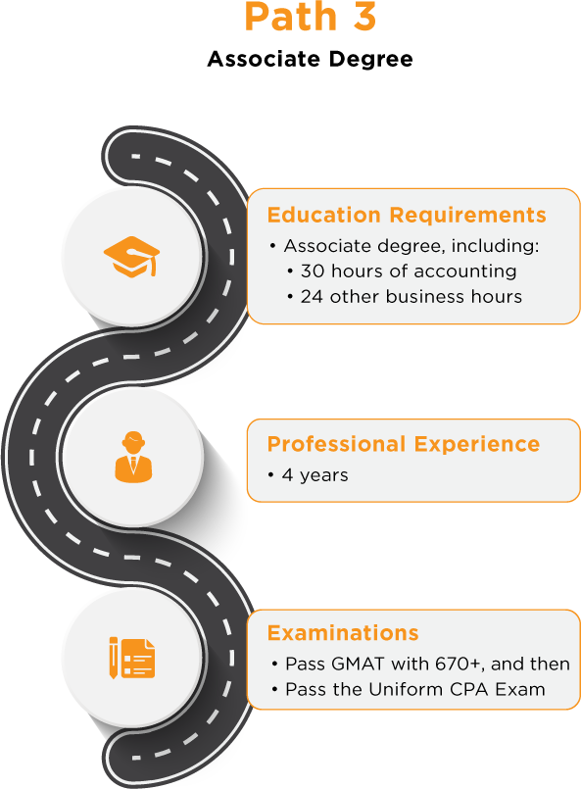
*Candidates from any state/territory who meet these requirements may have their test scores sent to Ohio/get their original certificate in Ohio.
Notes:
In addition to better telling our story, we need to find ways to increase the pathways to the profession and remove barriers to entry. Ohio is fortunate to have three unique pathways to licensure, giving our state’s CPA candidates multiple options to enter the profession. Each path requires passage of the new CPA Exam.
Path 1 – Candidates on this path must earn a baccalaureate degree or higher with a total of 150 semester hours. Those hours must include 30 hours of accounting coursework and 24 hours of other business courses. Candidates need to have one year of professional experience and must pass the Uniform CPA Exam.
Path 2 – Candidates who select this path must earn a baccalaureate degree with an estimated 122-126 semester hours. As in path 1, those hours must include 30 hours of accounting coursework and 24 hours of other business courses. This path requires four years of professional experience. These candidates must pass the GMAT with a score of 670+ AND pass the Uniform CPA Exam.
Path 3 – This final path allows candidates to earn an associate degree with an estimated 65 semester hours. As in paths 1 and 2, the required hours must include 30 hours of accounting coursework and 24 hours of other business courses. Like path 2, this path requires four years of professional experience, passing of the GMAT with a score of 670+ AND passing the Uniform CPA Exam.
NOTE: Candidates from any state or U.S. territory who meet these requirements may have their test scores sent to Ohio and/or obtain their original certificate in Ohio.

Slide 20
OTHER REMEDIES ALREADY ADOPTED
ABO reinstitutes credit for any parts of the CPA Exam that may have expired during the pandemic
NASBA expands timeframe for completing all four parts of CPA Exam to 30 months
Residency requirement dropped effective Oct. 3, 2023
Ohio to implement mandated reciprocal license to take effect Dec. 29, 2023
Notes:
We wanted to make sure you’re aware of several other remedies that may help your Pre-CPAs obtain the credential.
The ABO has reinstituted credit for any parts of the CPA Exam that may have expired for those who started taking the exam during the pandemic.
NASBA has expanded the timeframe for completing all four parts of the CPA Exam to 30 months; it was previously 18.
The ABO recently dropped the residency requirement for taking the exam or obtaining the CPA certificate. This means that any U.S. citizen can avail themselves of Ohio’s pathways to licensure.
Ohio law will implement mandated Ohio CPA reciprocal licensure on Dec. 29. That means that Ohio's Accountancy Board will recognize a valid license held in any other state.

Slide 21
MEASURES UNDER CONSIDERATION
Reduce the years of experience for Path 2 to two years
Pursue automatic mobility
Strike the GMAT score requirement from Paths 2 & 3
Notes:
Other measures we are exploring include:
Striking the GMAT score requirement from Paths 2 & 3. The CPA Exam itself provides sufficient rigor. When combined with the experience requirements outlined for Paths 2 & 3, we believe it adequately prepares a candidate for licensure.
Reducing the years of experience for Path 2 to two years. This would make each path equivalent in years of education and experience (i.e. Path 1 is 5 years of education and 1 year of experience = 6; Path 2 would be 4 years of education and 2 years experience = 6; Path 3 is 2 years of education and 4 years of experience = 6).
Pursuing automatic mobility.

Slide 22
THE FIVE-POINT PLAN
Work Experience
Collaboration
Messaging
Curriculum
Pathways
Notes:
Over the last six months, we met with the key stakeholders in the business, education, nonprofit, and government sectors as well as students and YCPAs, to gather their input as we worked to formulate this plan. This framework is the culmination of that work aimed at changing the trajectory of the profession’s future. The five-point plan lays out as follows:
Collaboration – Our goal with this pillar is to establish a well-resourced and highly connected industry sector partnership to manage Ohio’s accounting workforce talent strategy.
Messaging – We need to change the accounting story, how it’s told, where it’s told, and by whom, so we can shift perceptions of our profession, drive engagement from our most critical stakeholders, and refill our talent pipeline.
Curriculum – We want to attract more people to the profession by providing engaging educational experiences that accurately reflect the work of accounting professionals.
Work Experience – We want to increase attraction to and retention of people to the accounting profession by providing meaningful work experiences and work cultures.
Pathways – We seek to remove unnecessary barriers to entry and increase opportunities for individuals to pursue accounting careers and CPA licensing.
This framework—which includes a detailed action plan for each pillar—offers the potential for scalability beyond Ohio’s borders and can possibly serve as a national model for the profession.

Slide 23
SIX THINGS YOU CAN DO TO SUPPORT THE PIPELINE
Invest/Participate in The Ohio CPA Foundation’s student programming
Reach out to Lori Brown for more info: lsbrown@ohiocpa.com
Get into high schools and colleges on your own consistently
This Way to CPA
Start Here, Go Places
Support CPA candidates
PCPS CPA Culture Toolkit
Bonuses
Pay for study materials in advance
Develop cohorts
Provide time to study and take exam
Assign mentors
Track progress and build accountability
Notes:
How can you get involved and make a difference? We’ve identified six things you can do right now to support expansion of the future CPA pipeline:
Invest & participate in The Ohio CPA Foundation’s student programming. Reach out to Lori Brown in our office for more info.
Get into high school and colleges on your own consistently. For ideas on how to get started, check out This Way to CPA and Start Here, Go Places. We’ll put the links to those resources in the chat.
Support CPA candidates in your organization:
Pay bonuses for obtaining the credential
Pay for study materials
Develop cohorts to help keep candidates motivated
Provide time for candidates to study and take the exam
Assign mentors to assist candidates throughout the process
Track progress and build accountability

Slide 24
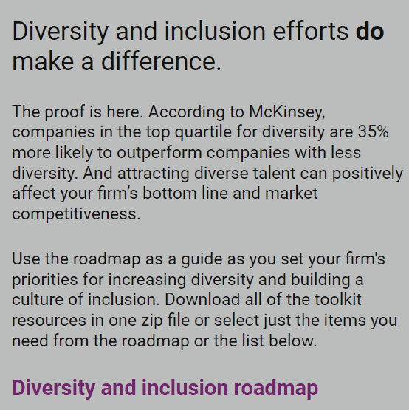
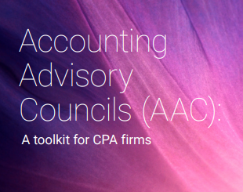
SIX THINGS YOU CAN DO TO SUPPORT THE PIPELINE
Recruit differently (HBCUs and MSIs)
PCPS Diversity Toolkit
George Willie Scholarship and Internship program
Meaningful engagement with university advisory boards
PCPS Accounting Advisory Council Toolkit
Become an employer of choice
Notes:
4. Recruit differently—visit historically Black colleges and universities as well as minority serving institutions
For details, check out the PCPS Diversity Toolkit & the George Willie Scholarship & Internship program
5. Engage with university advisory boards
Get tips from the PCPS Accounting Advisory Council Toolkit
6. Become an employer of choice – create a workplace culture that people are proud to be a part of and never want to leave

Slide 25
POTENTIAL FUNDING SOURCES
The Ohio Accounting Talent Coalition
Notes:
Resolving the talent shortage is going to require a long-term approach that involves everyone working together. It will also require significant funding to make it happen. The Ohio Society is exploring a variety of options.
OSCPA and the Ohio CPA Foundation are investigating a variety of funding resources to advance our efforts to address the talent shortage.
We have applied for an Industry Sector Partnership Grant through the Governor’s Office of Workforce Transformation. If we are awarded the Spark Grant, it will provide seed money for our initial messaging efforts.
Though not an overt funding source, Ohio’s Credit Plus program is something we plan to leverage to help high school students reduce the cost of obtaining an accounting degree.
Though also not a direct funding source, Ohio’s TechCred program is another way we plan to help recent graduates and existing workers upskill and reskill for the technology driven accounting jobs of the future.
Underpinning all these funding opportunities is our Ohio Accounting Talent Coalition. We are working to build a highly functional and well-equipped coalition of leaders in business, industry, nonprofit and academia that will commit time, money and resources toward our talent initiatives.
The way forward is with all of us working together.

Slide 26
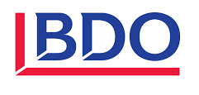
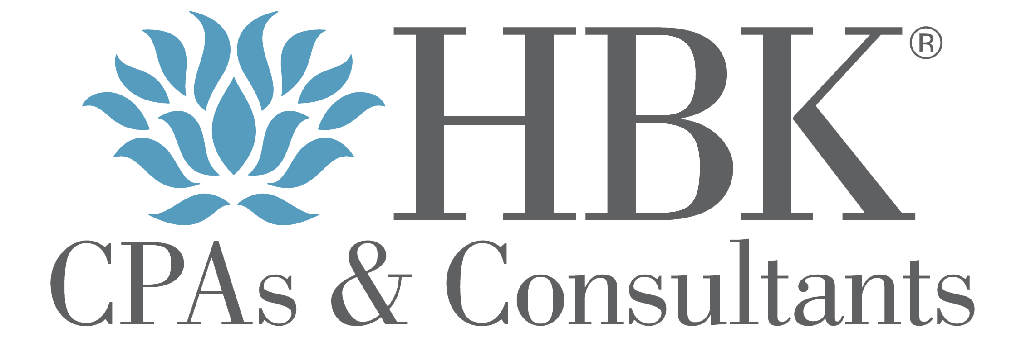
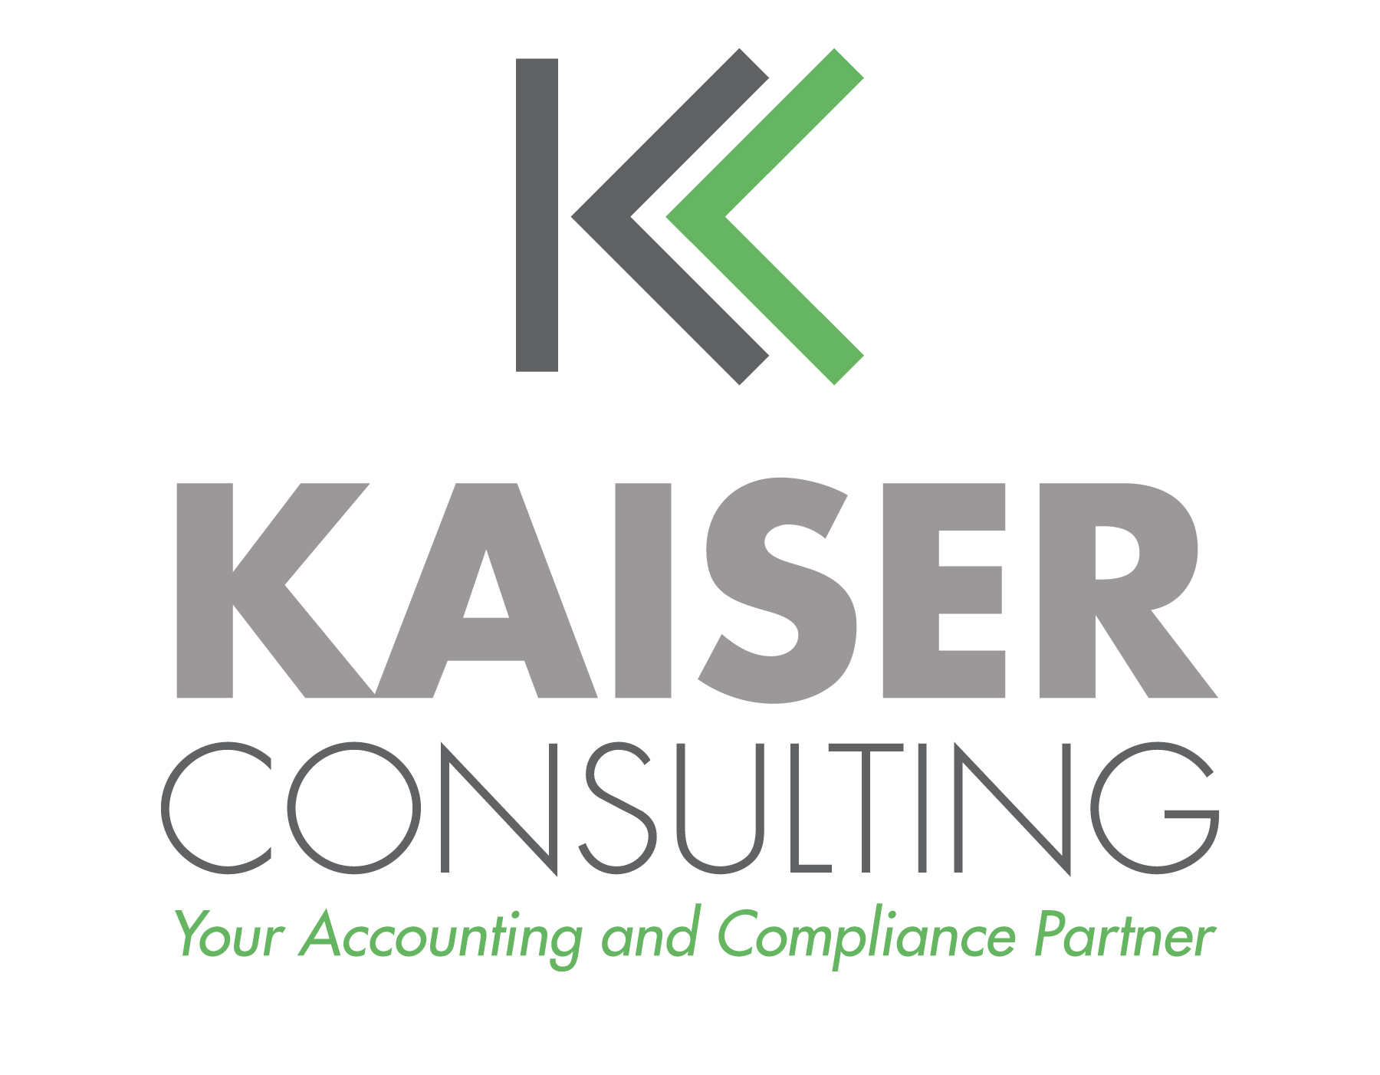
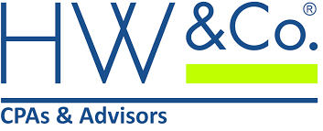
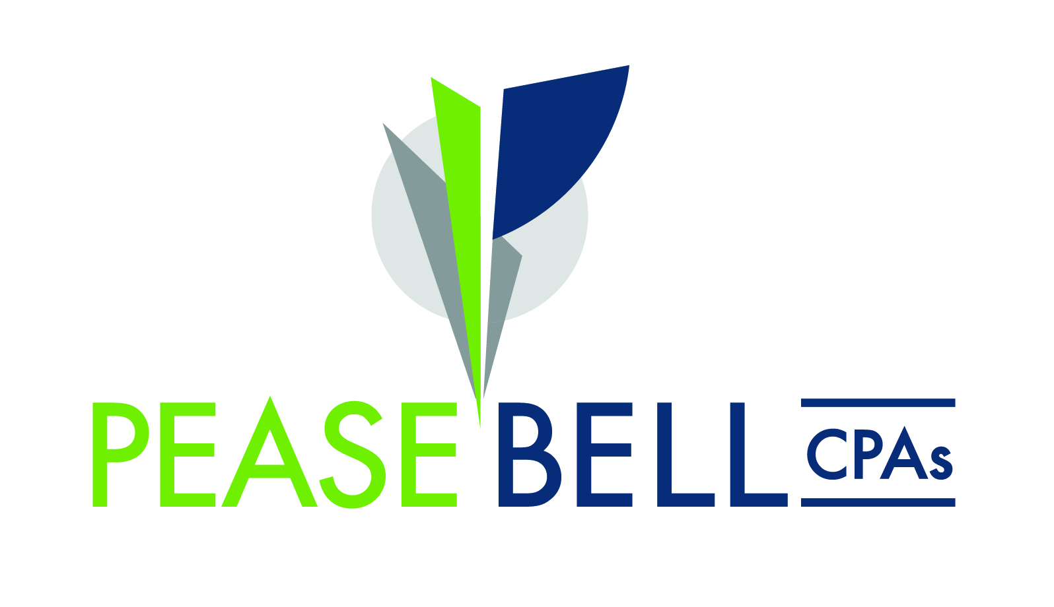
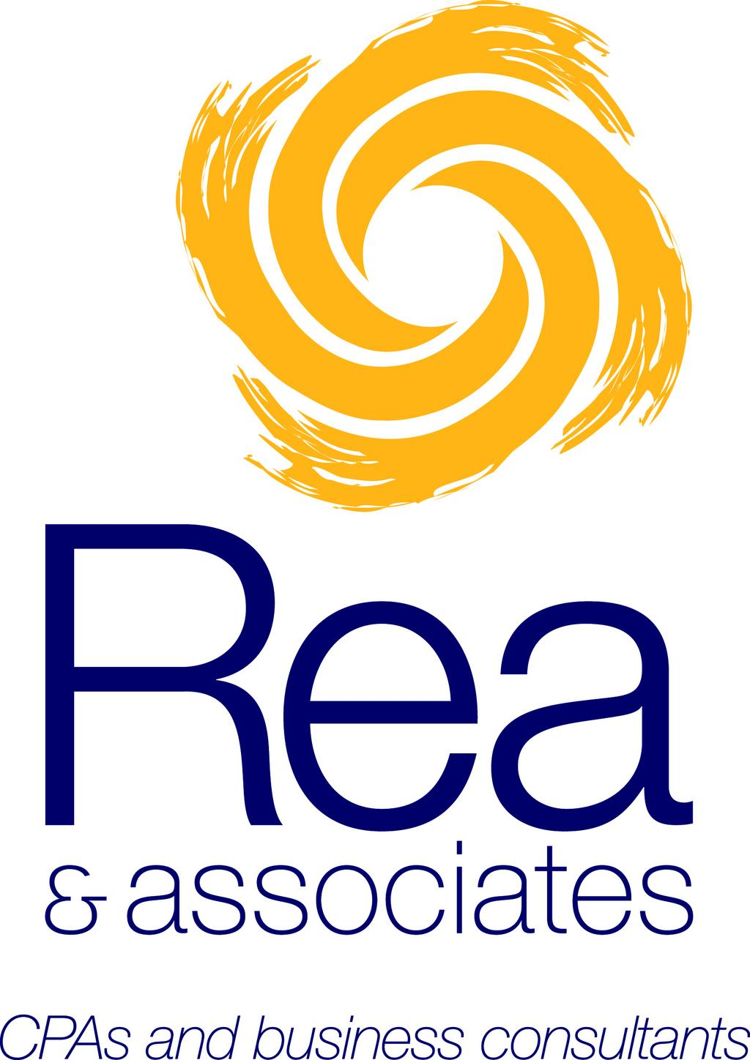
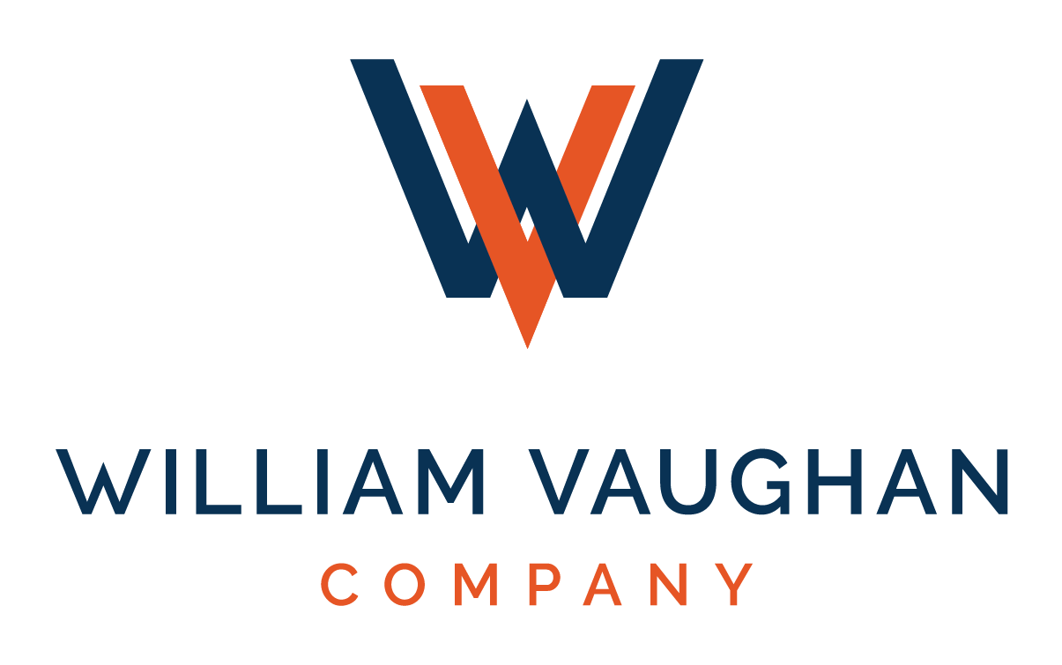
2023 Supporters of The Ohio CPA Foundation!
Notes:
And finally, we are counting on the continued financial support of individuals and organizations that are committed to and invested in resolving the talent shortage. Nearly 50 companies and more than 1,000 donors are supporting the work of the Foundation and the student initiatives it funds.

Slide 27
QUESTIONS?
Notes:
That’s all we have time for today. I’ll be happy to answer any questions you may have.
Thank you for participating today. Enjoy the rest of the Accounting Show.

